Slide 1




X
CAPSTONE QA AUTOMATION PROJECT
SauceDemo Automation
Presentated by Ashutosh Soni

Slide 2


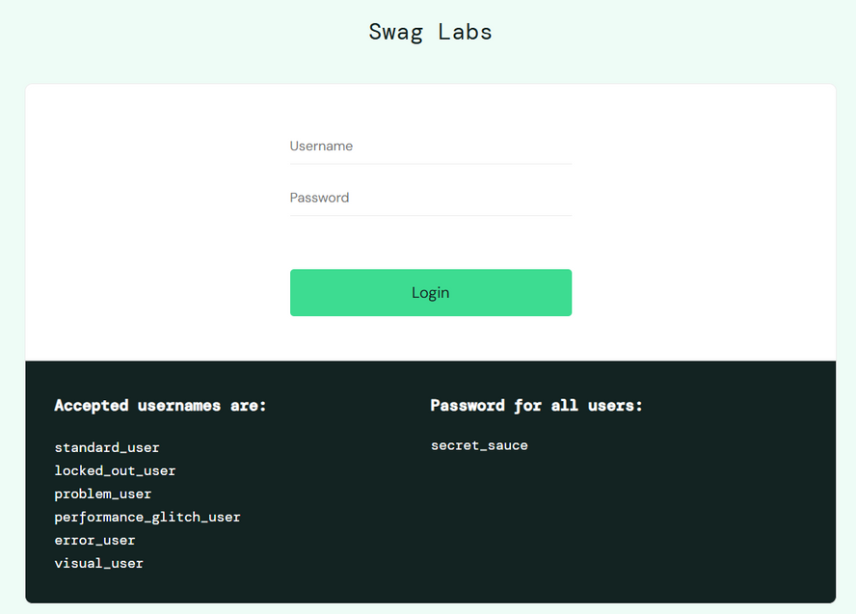

Project Description
My Capstone Project focused on developing a robust automated testing framework for a web application (https://www.saucedemo.com). The goal was to automate functional testing, integrate the test framework into a CI/CD pipeline, and ensure continuous validation of application stability.
GITHUB REPO URL:
https://github.com/beingashusoni/SauceAutomation_Capstone_Project.git
Page 01

Slide 3


Type of Testing & Tools Used
Tools Used:
Java
Selenium
WebDriver
TestNG
Cucumber (BDD Framework)
Maven (Build and Dependency Management)
GitHub (Version Control)
Jenkins (CI/CD Automation)
JIRA (Requirement & Defect Management)
Extent Reports (HTML Reporting)
Type of Testing:
Manual Testing
Automation Testing with CI/CD integration
Page 02

Slide 4
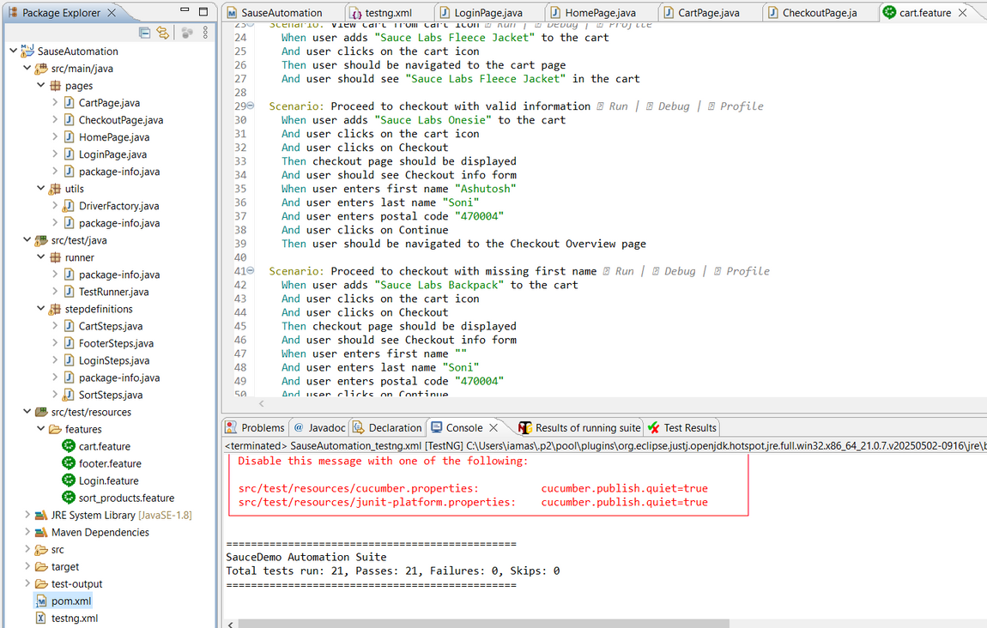
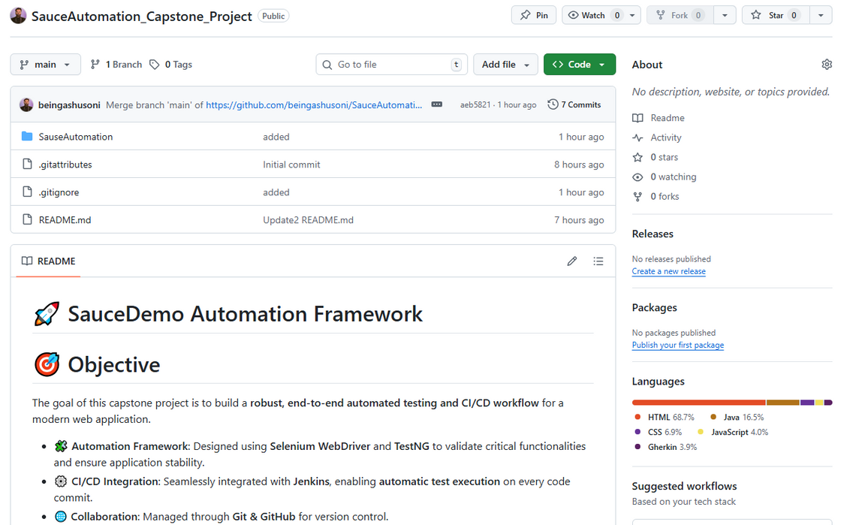
Screenshots
from
Eclipse and
Github Repository
Page 03

Slide 5
Automation Approach
01
02
03
04
Page Object Model (POM)
Cross-Browser Testing
Maven Build System
Java & Selenium
Organized classes for each web page for reusability and maintainability
Executed tests on Chrome and Firefox browsers
Managed dependencies and build configurations
Java programming language for scripting, Selenium for automation
Page 04

Slide 6

Developed automation scripts using Selenium WebDriver + TestNG + Cucumber
Work Description
Implemented integration with Jenkins for automated test execution on each code commit
Managed requirements and test cases in JIRA with active tracking of tasks and bugs
Produced detailed HTML reports with screenshots on test failure using Extent Reports
Conducted manual testing using Zphyr Board in JIRA for Sprint backlog management
Page 05

Slide 7
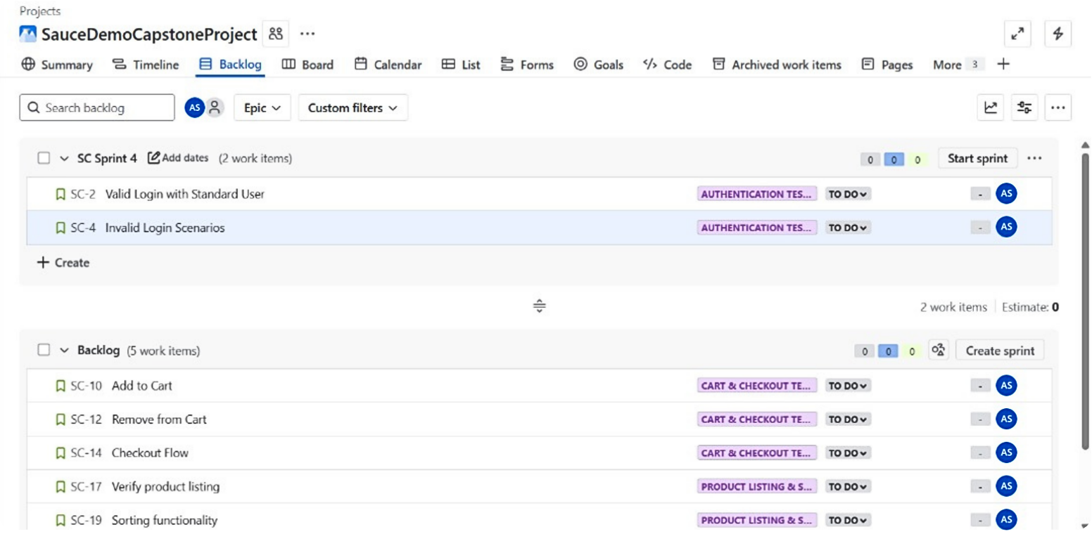
JIRA Backlog Screenshot
Page 06

Slide 8
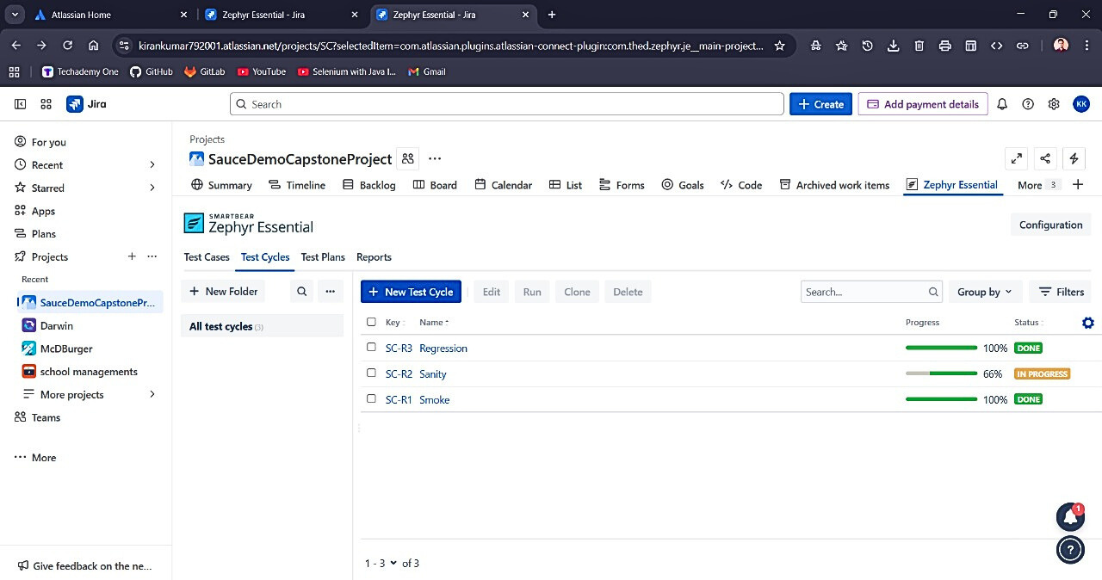
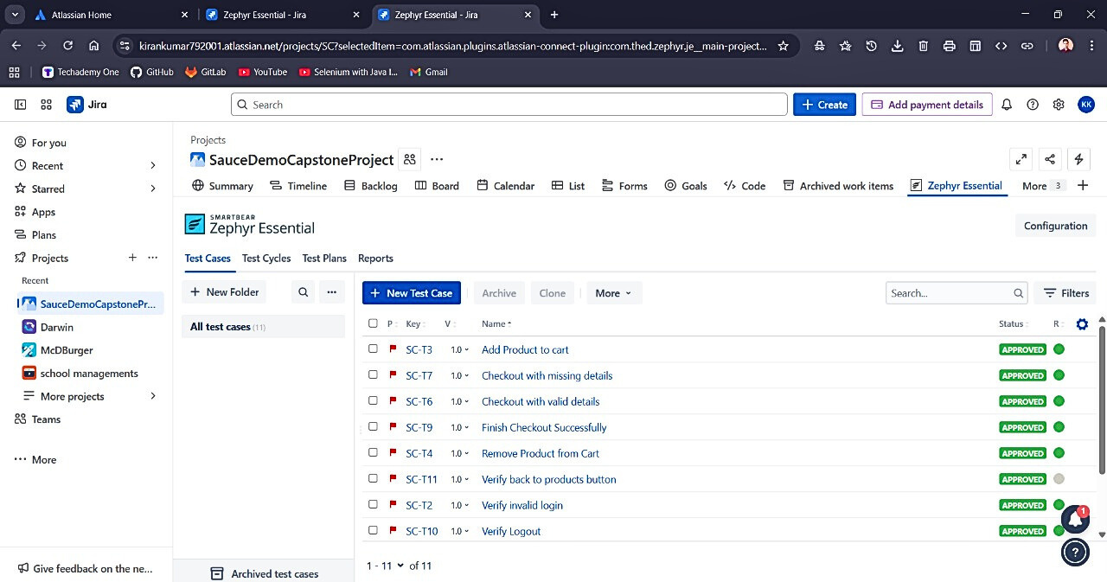
Zephyr Board
Smoke , Sanity, Regression
Test Case
Page 07

Slide 9
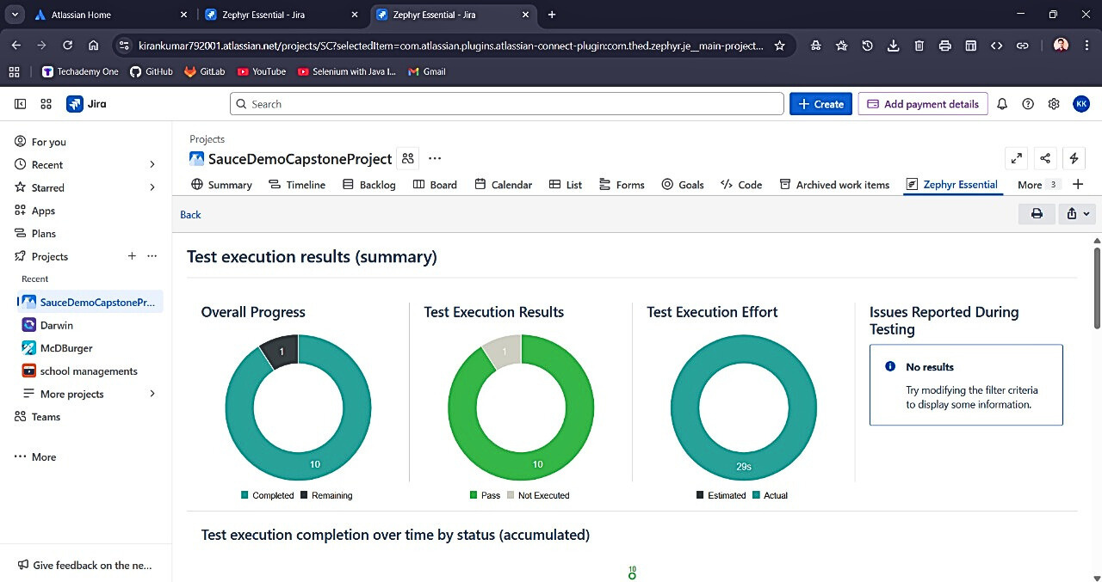
Test report from Zephyr Screenshot
Page 08

Slide 10
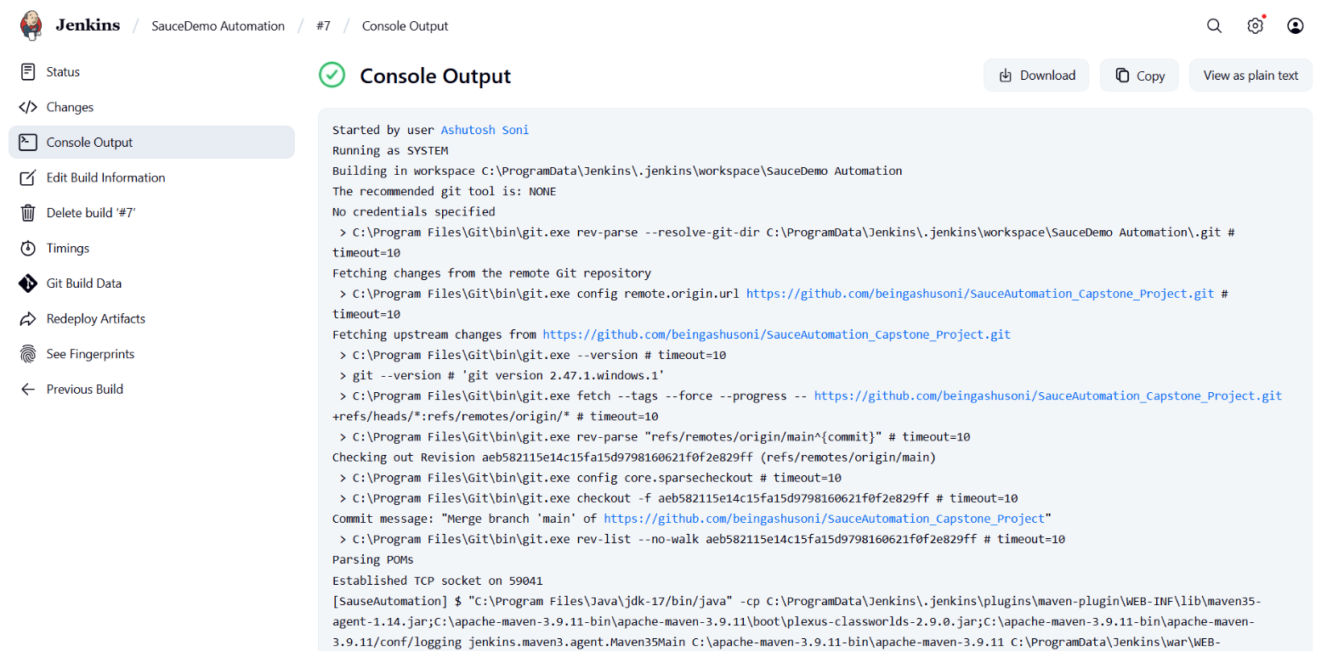
Jenkins Screenshot
Page 09

Slide 11

THANK
YOU
Presentated by Ashutosh Soni

